Slide 1
Problem Statement: To Identify Hot Leads to Increase Conversion Rate

Slide 2
Lead – Conversion Process
Lead to Conversion process
Lead Generation via referrals and ads on websites like Google
Visit to X Education website by these potential customers (professionals)
Visitors provide contact details
Calling and reaching out to all the leads
~30% leads get converted
Proposed Solution:
A model to filter leads
to increase the conversion ratio

Slide 3
Proposed Solution
Selection of Hot Leads
Communicating with Hot Leads
Conversion of Hot Leads
Focus Communication
Since we would know more about this smaller
Increase Conversion
Since we focussed on hot leads, which were more probable to convert, we would have a better conversion rate.
Leads Clustering
We cluster the leads into certain categories based on their tendency or
set of leads, we can have an impactful conversation.
probability to convert, thus, reducing the sample size but getting more efficiency.

Slide 4
Implementation

Slide 5


Loading and Observing past data provided by the company
Univariate, bivariate, and heatmap for numerical and categorical columns
Performing pre-requisites for RFE and logistic regression
Data Gathering
Data Cleaning
Performing EDA
Data Preparation
Model Building
Removing duplicate values, treating null values, eliminating unnecessary column, etc.
Treating outlier, Feature Standardisation

Slide 6
Selection of top features using RFE
Reduction of columns and model re-building
Verifying our final model accuracy with PCA
Feature Selection
Model Building
Model Improvement
Final Model
Verifying with PCA
Model building using RFE for selected columns
Final model analysis and performance on test data

Slide 7
Plots (Visualisation)

Slide 8
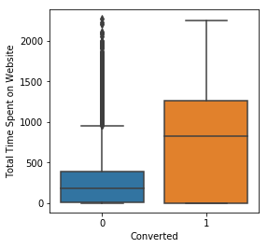
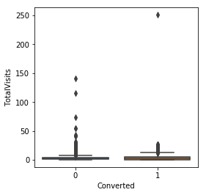
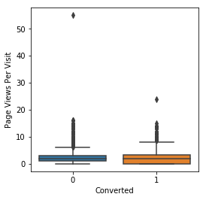
Plots depicting variation in numerical columns with converted

Slide 9
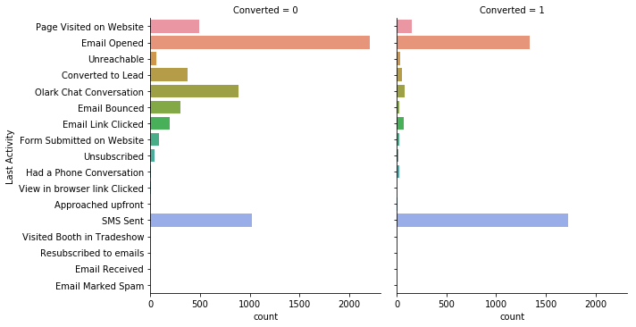
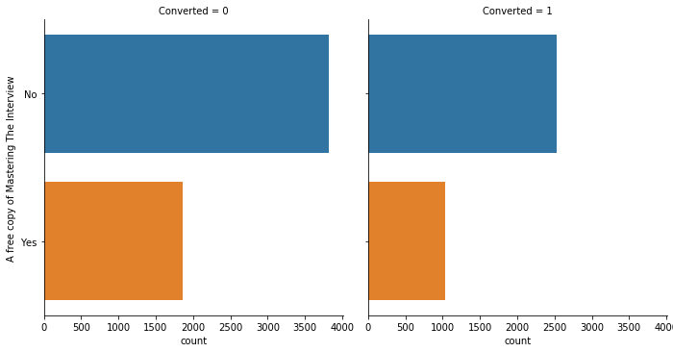
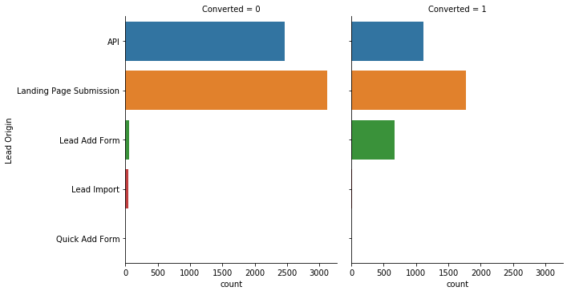
Plots depicting variation in Last Activity, Mastering the interview and Lead origin for those who Converted vs those who didn’t

Slide 10
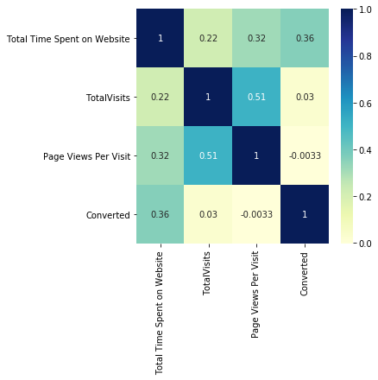
Heat map of all selected numerical columns

Slide 11
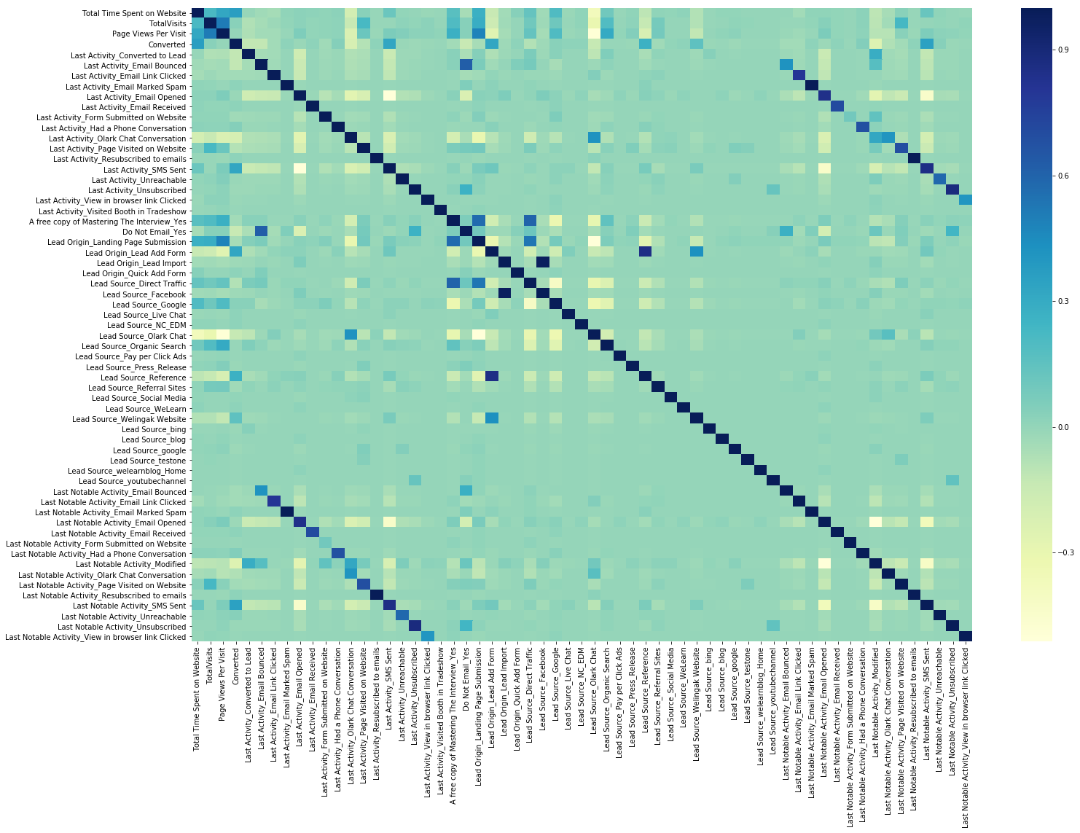
Heat map for all selected columns (numerical columns

Slide 12
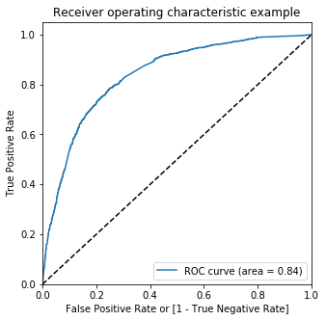
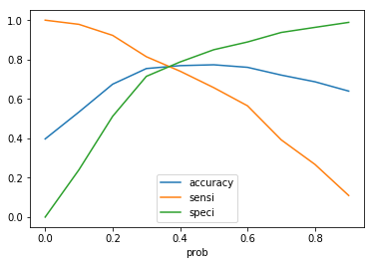
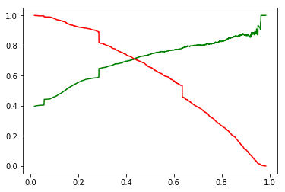
Linear Regression Final Model Parameters
Area under ROC = 0.84 Intermediate cut-off = 0.35 Final cut-off = 0.42

Slide 13
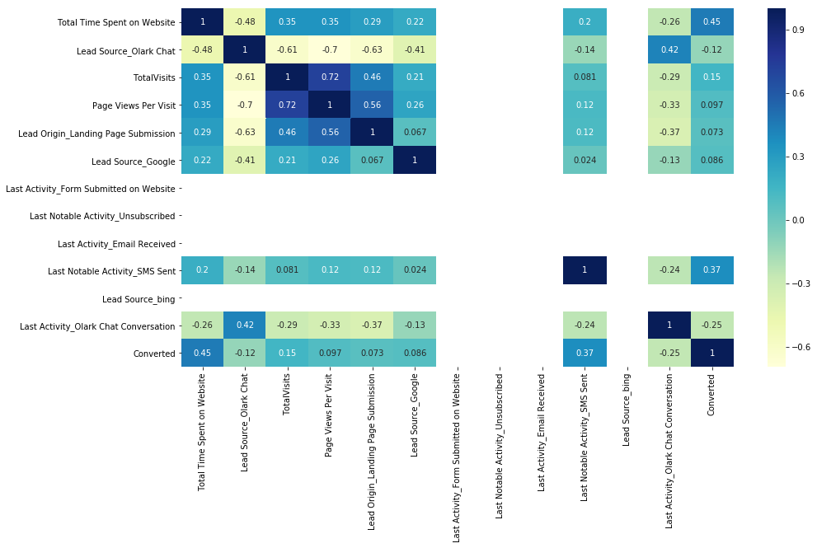
Heat Map of all selected columns in our final model

Slide 14
Inference / Conclusion

Slide 15
Model Analysis
Overall accuracy on Test set: 0.81
Sensitivity of our logistic regression model: 0.82
Performance of our Final Model
Specificity of our logistic regression model: 0.82

Slide 16
Inferences from Model
Top 3 variables in our model that contribute towards lead conversion are:
Total Time Spent on Website
TotalVisits
Lead Origin
Business Insights Derived from our Model

Slide 17
Inferences from Model
Top 3 variables in my model, that should be focused are:
Last Activity_SMS Sent (positive impact)
Last Activity_Olark Chat Conversation (negative impact)
Lead Source_Olark Chat (negative impacting)
Business Insights Derived from our Model

